Slide 1
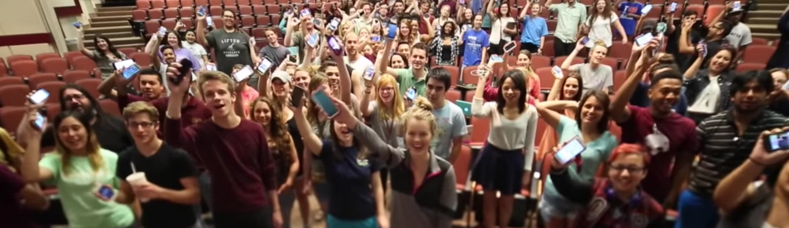
Fundamentals of Digital & Online Media
Jon zmikly
jz18@txstate.edu
@jonzmikly

Slide 2
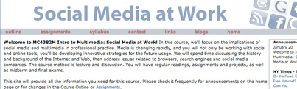
Course origin
First taught as Social Media at Work, Spring 2010
Elective, converted to required course in 2011
Taught as large lecture, sometimes taught as smaller sections in summer, online, Round Rock, etc.
Since 2014, added labs to provide personalized instruction and support to students in FDOM (every other Friday).

Slide 3
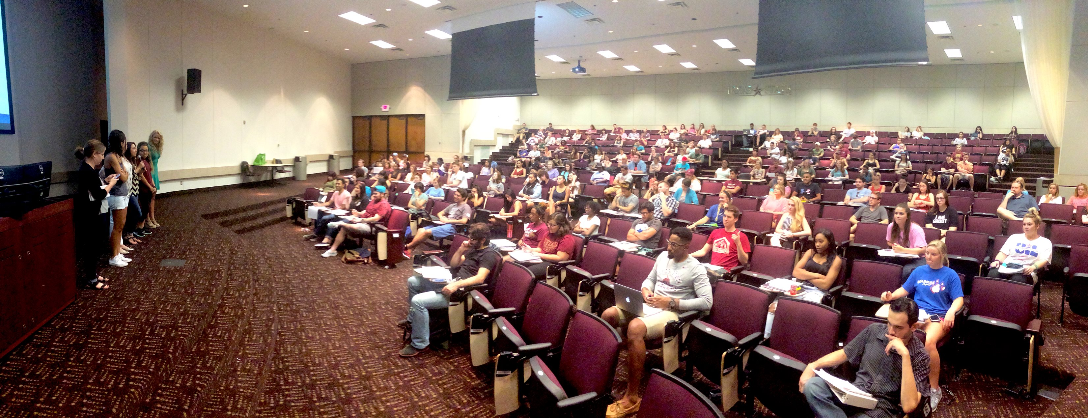
Course origin
Jon Zmikly taught large section from 2014-2016
Dale Blasingame taught large section from 2016-2019
Honed labs / checkpoints, added new features, updated attendance policy, new modules / topics (Trust on the Web, Drones), trivia game, etc.

Slide 4

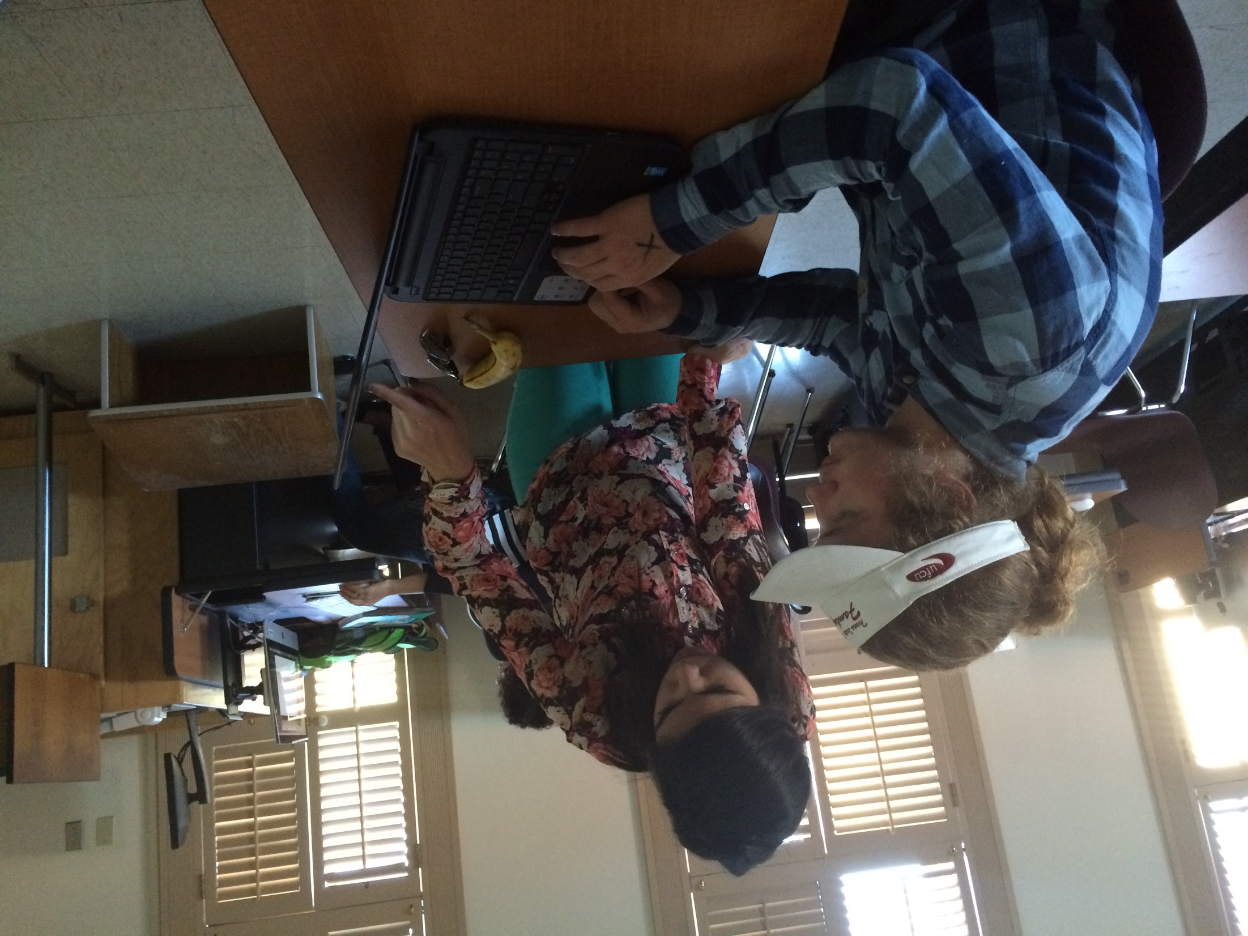
Course rationale
Found that in many cases, students were having trouble gaining employment if they had not taken certain digitally focused electives
Wanted to bring concepts from graduate Digital Issues course to undergraduates
Wanted students to have digital foundation to bring to other classes across their majors.

Slide 5
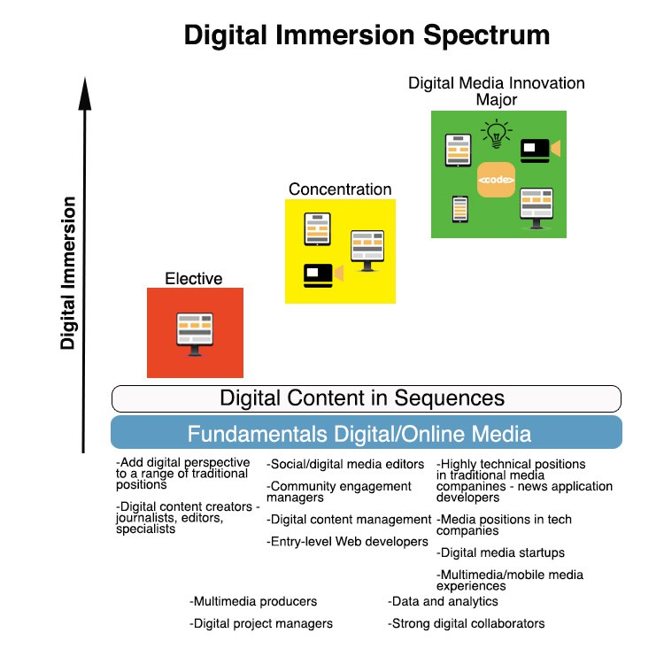
Course rationale

Slide 6
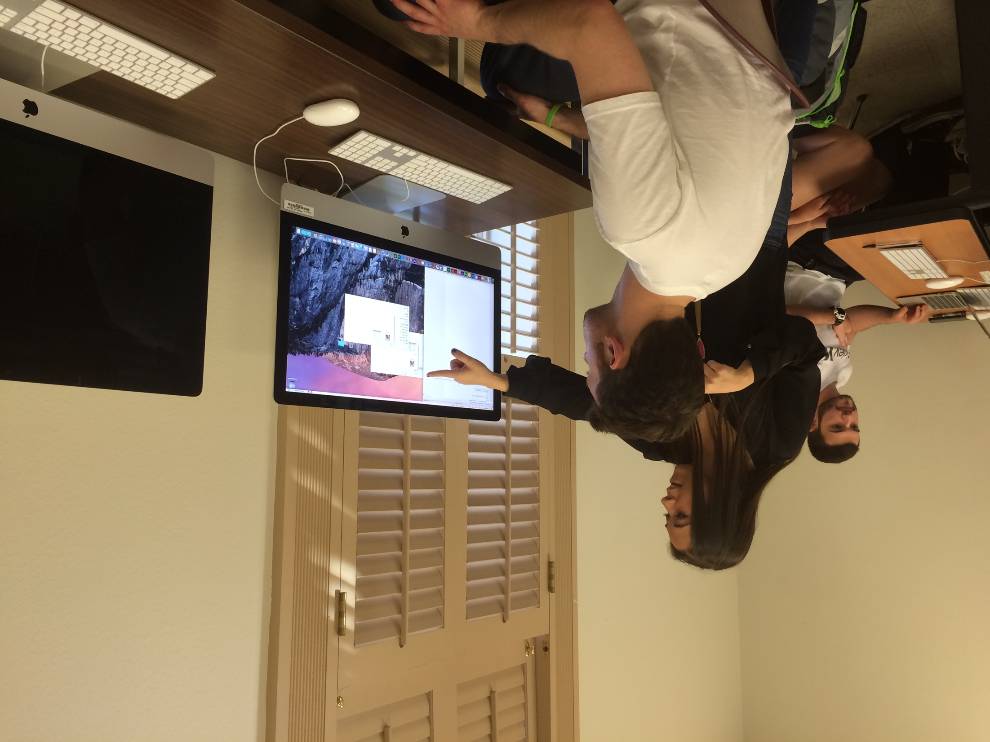
Course rationale
Allow students to develop a digital footprint and explore personal brand
Highlight the opportunities and pitfalls of an online social presence
Other digital courses in undergraduate curriculum Web Design, Multimedia Journalism, Visual Communication, Digital Storytelling, Coding and Data for Communicators, Advanced Social Media, Digital Media Ethics, Digital Media Tools and Skills, a Coding Workshop course, Drones and Sensors, VR/AR, 360 Video, Mobile Development, and Analytics, Digital Entrepreneurship, Chatbots.

Slide 7
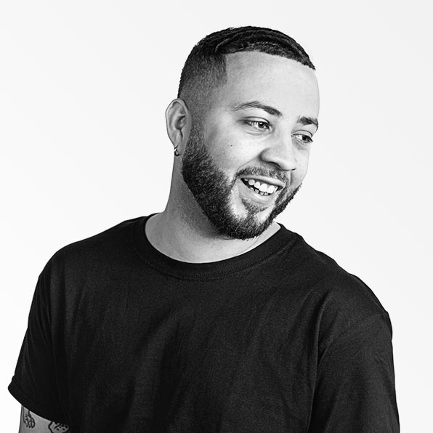
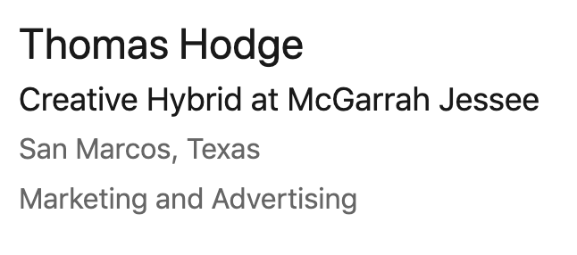
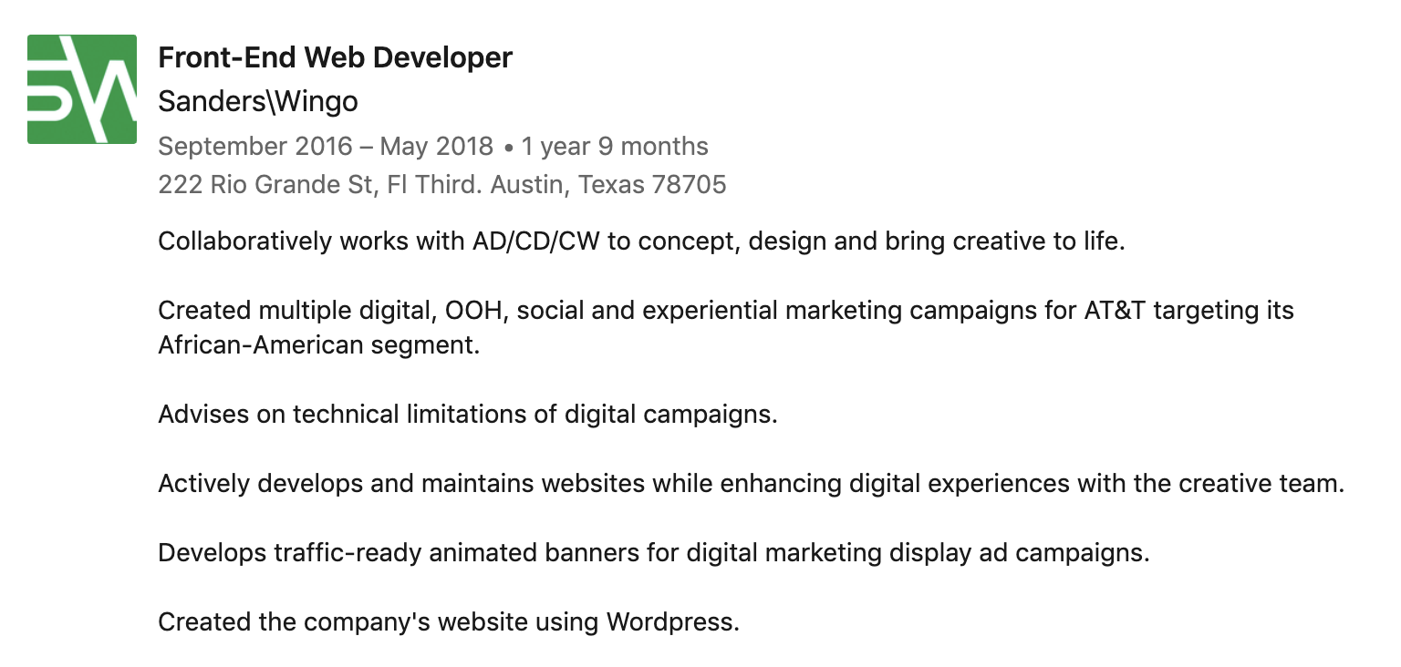
Success Stories

Slide 8
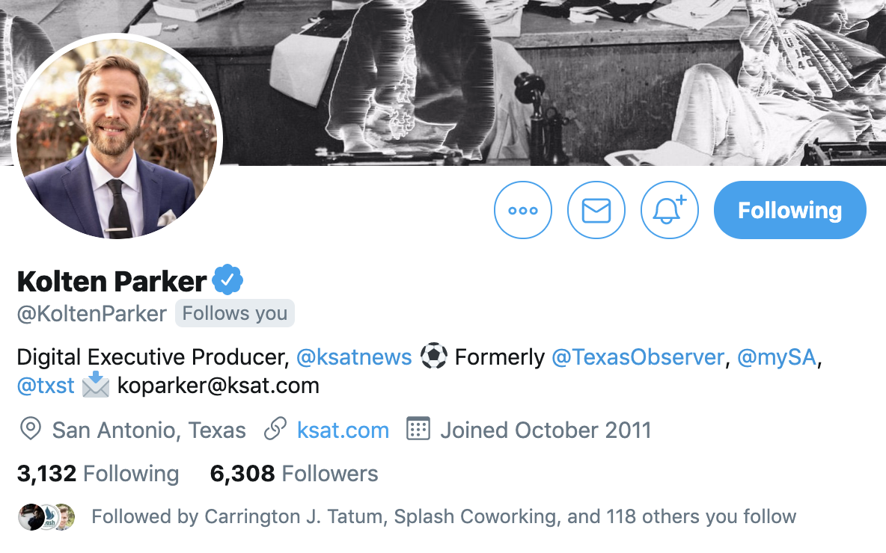
Success Stories

Slide 9
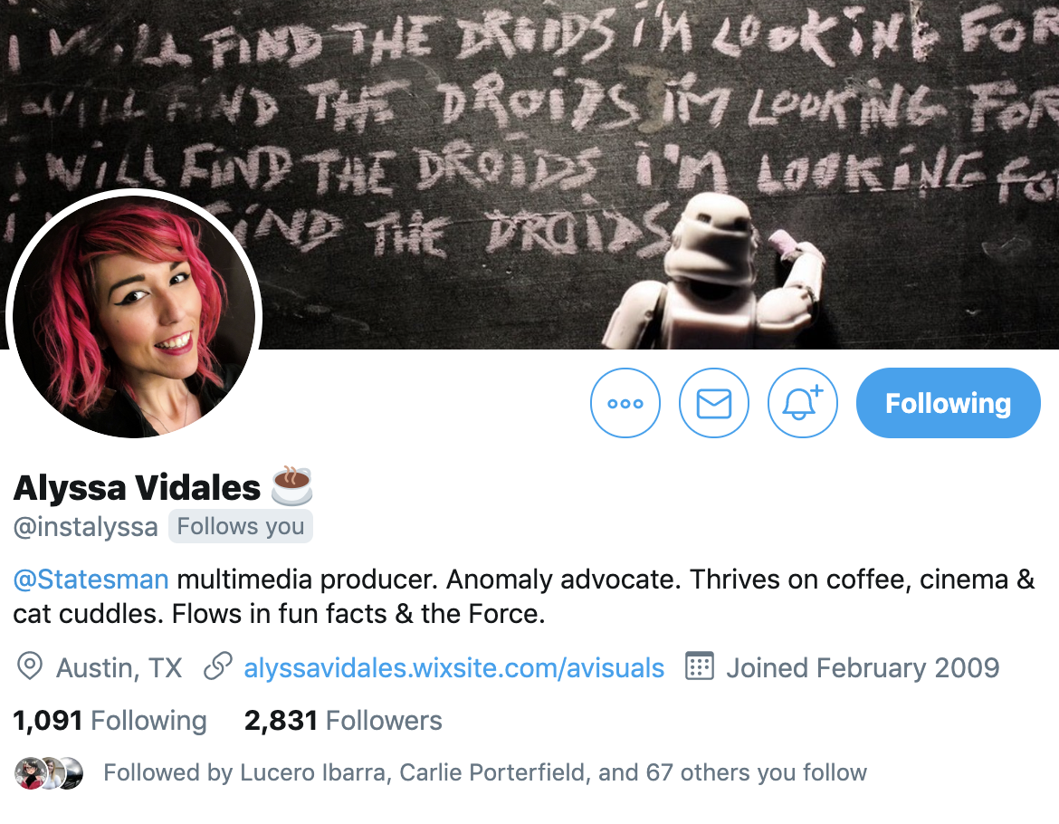
Success Story

Slide 10


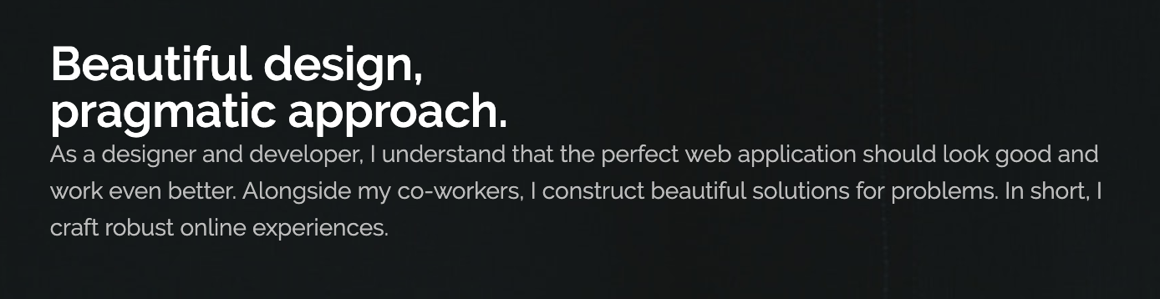
Success Story

Slide 11


Success Story

Slide 12
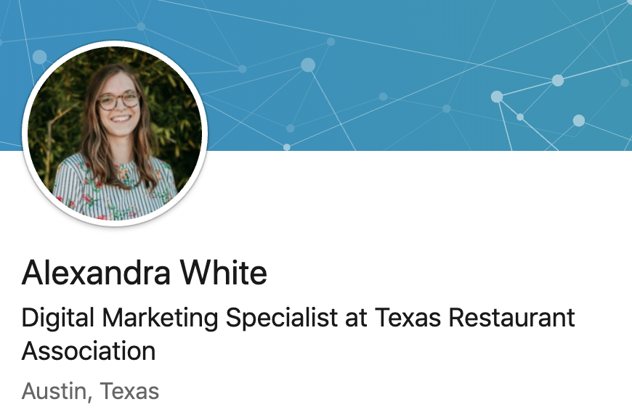
Success Story

Slide 13

Course topics
History of Internet and Web
Web Writing / Effective Digital Content
Basic Web Design - HTML/CSS, Browsers
Search Engines, SEO
Social Media and Personal Branding
Online Business Models
App Development
Multimedia / Emerging Media
Data Storytelling
Course topics are regularly revisited and updated to keep up with the changing digital landscape; news and current events important aspect of the course.

Slide 14
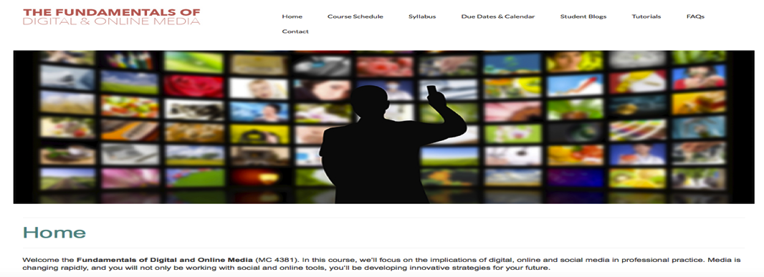
FDOM
Two lecture sections of ~200 students each week (Monday or Wednesday).
Students will attend an in-person lab every Friday to work on assignments and complete Checkpoints.
Online modules & assessments will be delivered weekly.
Lecture topics relate to lab and online material.
Course outline, video tutorials, and other resources will be hosted at www.fdom.jonzmikly.com, as well as TRACS.
TRACS will also be used for Gradebook, Syllabus, Assignment descriptions and submissions, Online Modules, mass emails, link to class site.

Slide 15
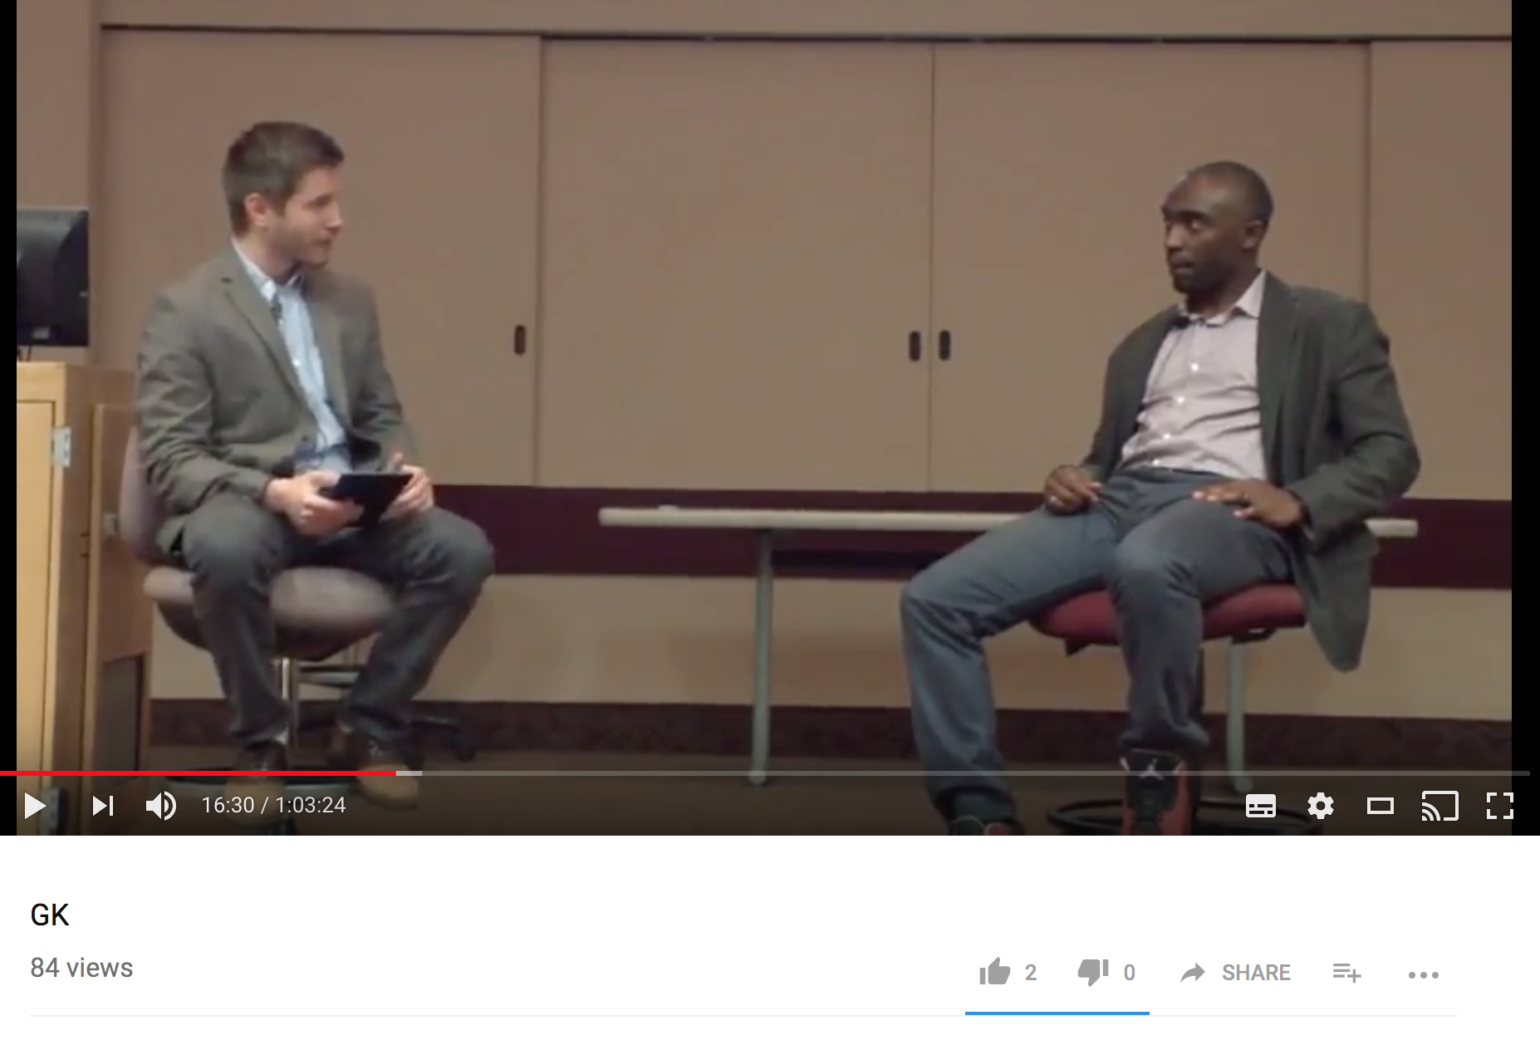
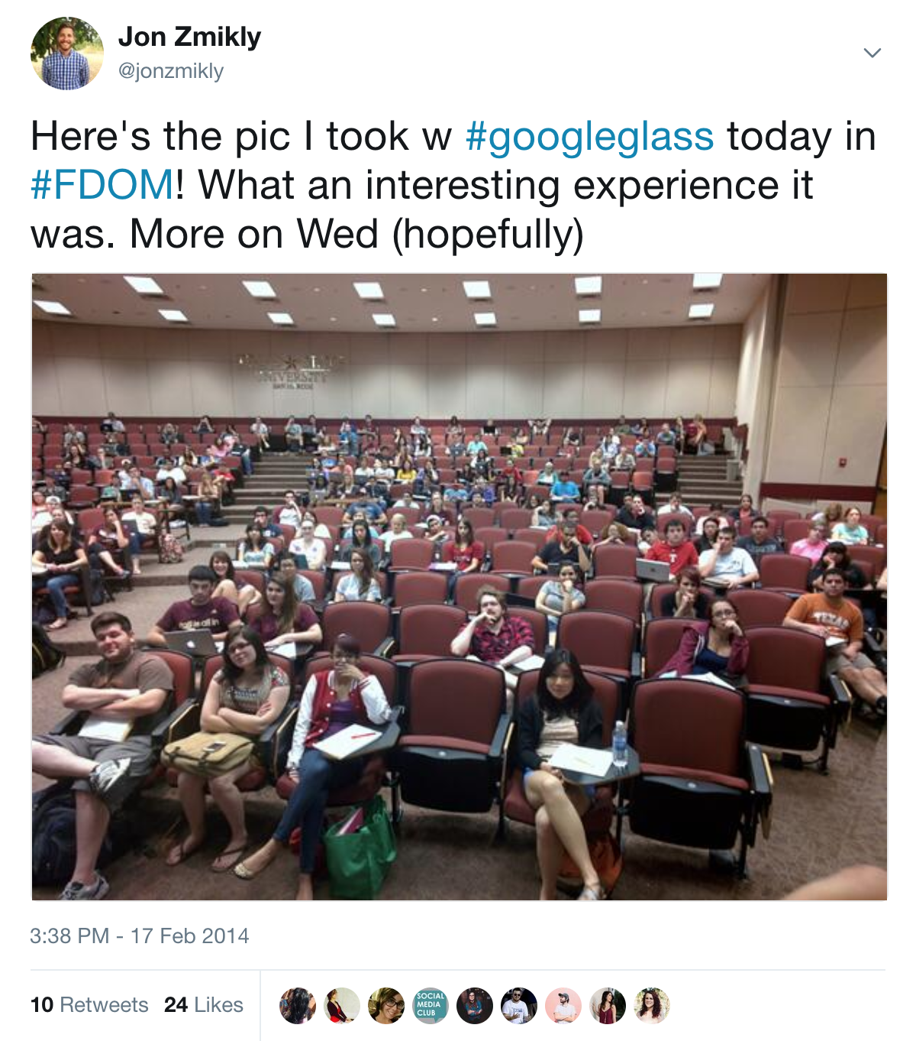
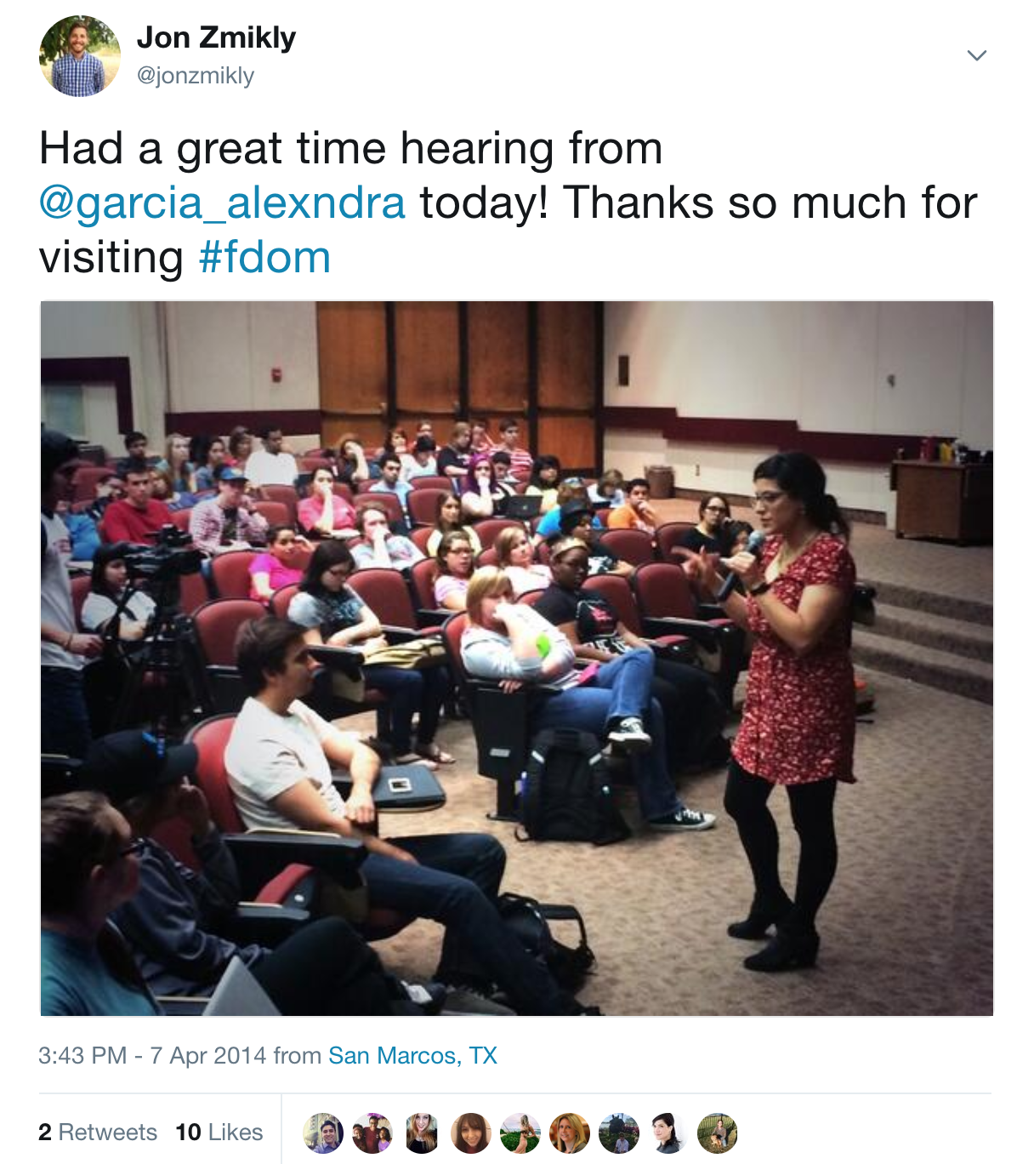
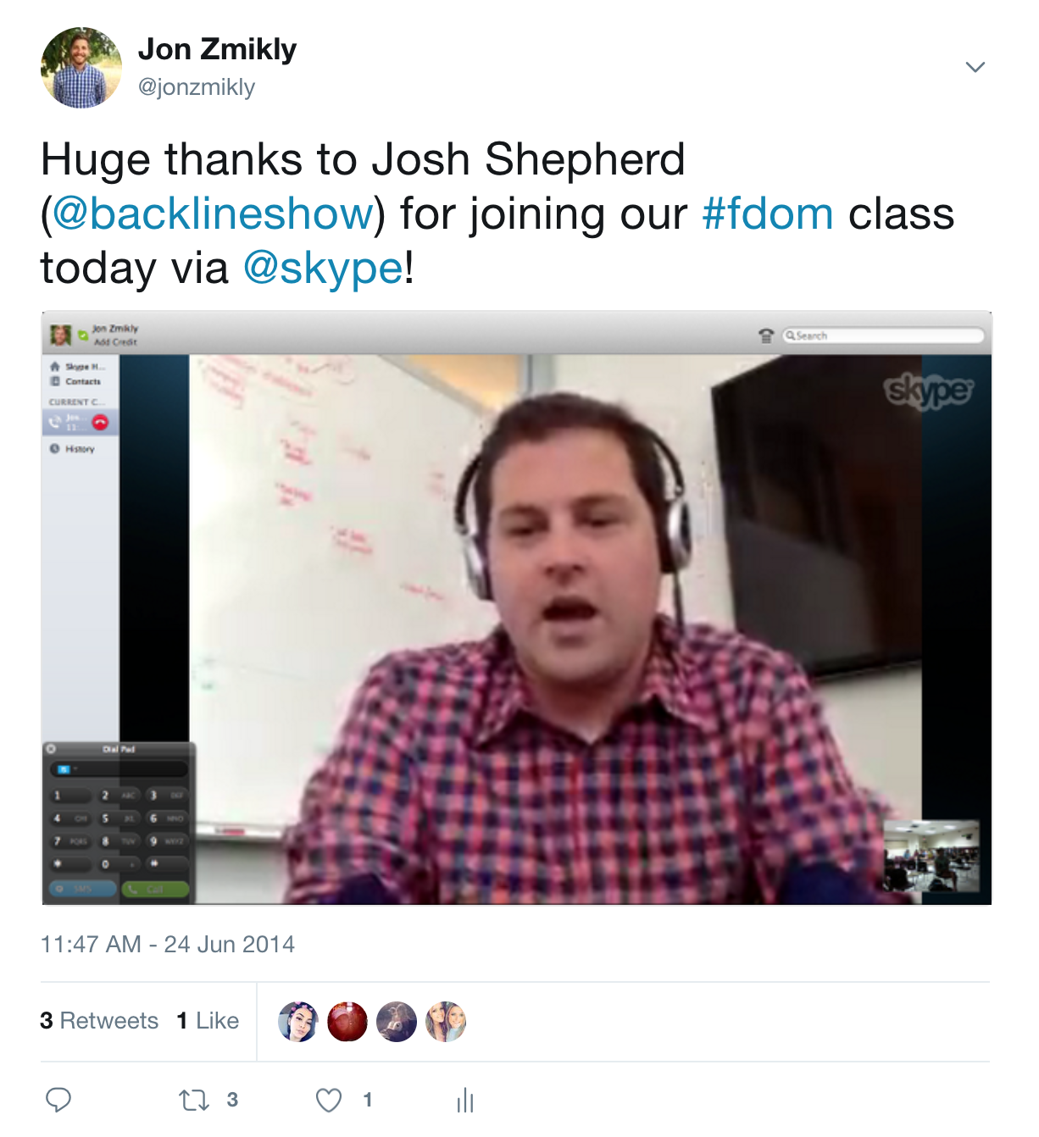
FDOM

Slide 16
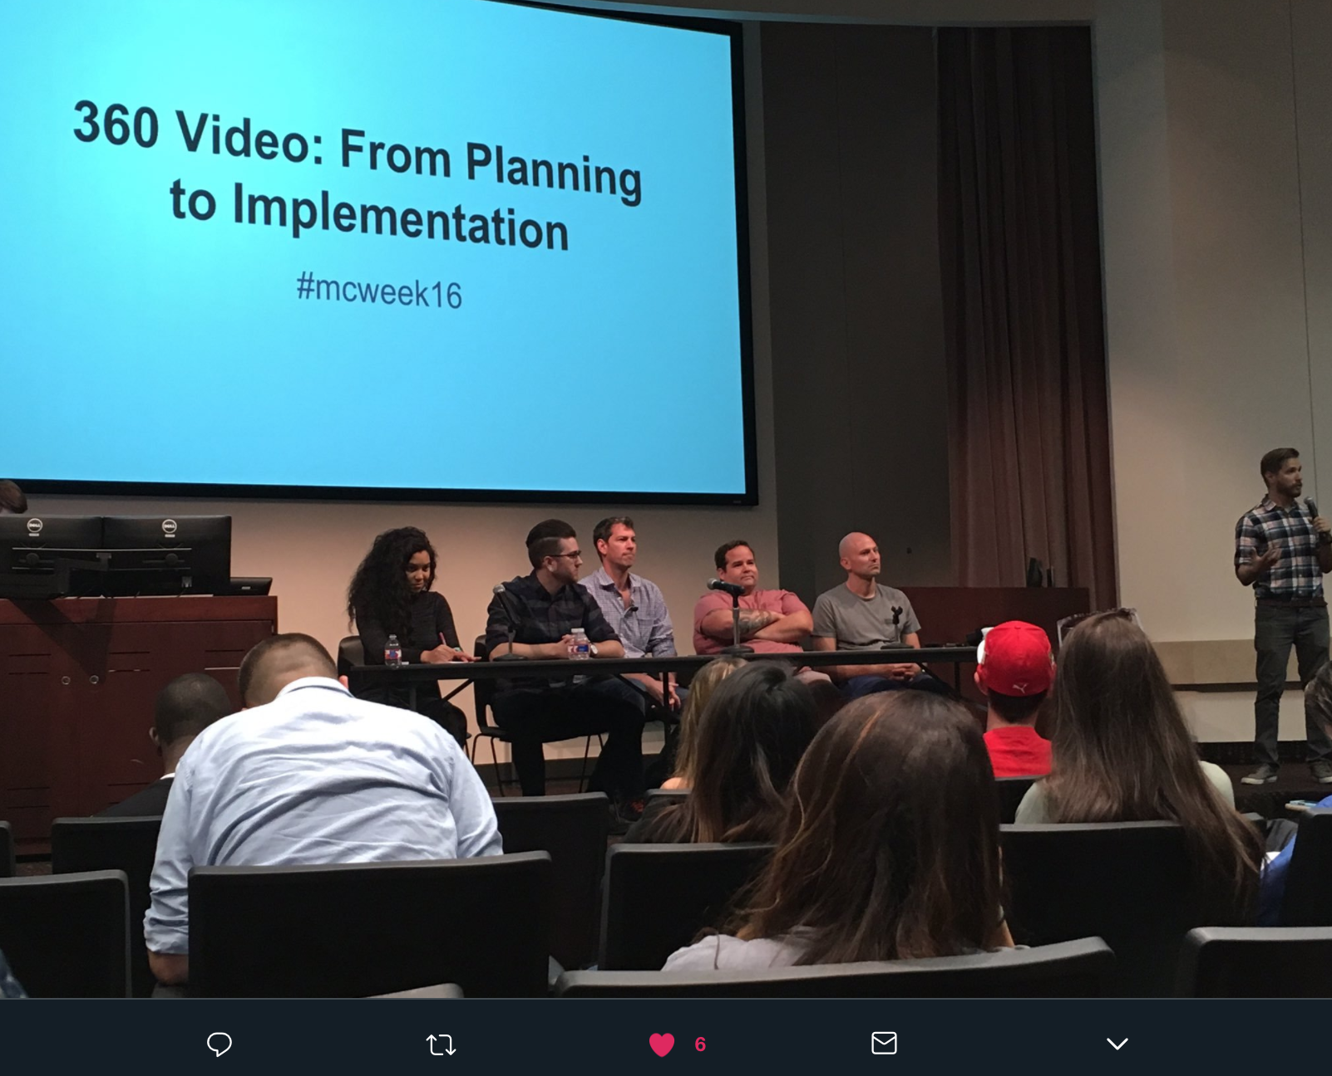
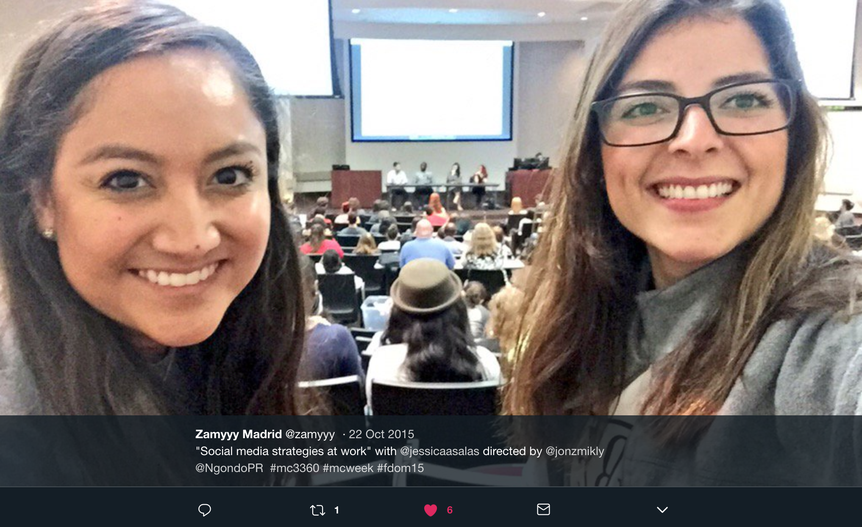
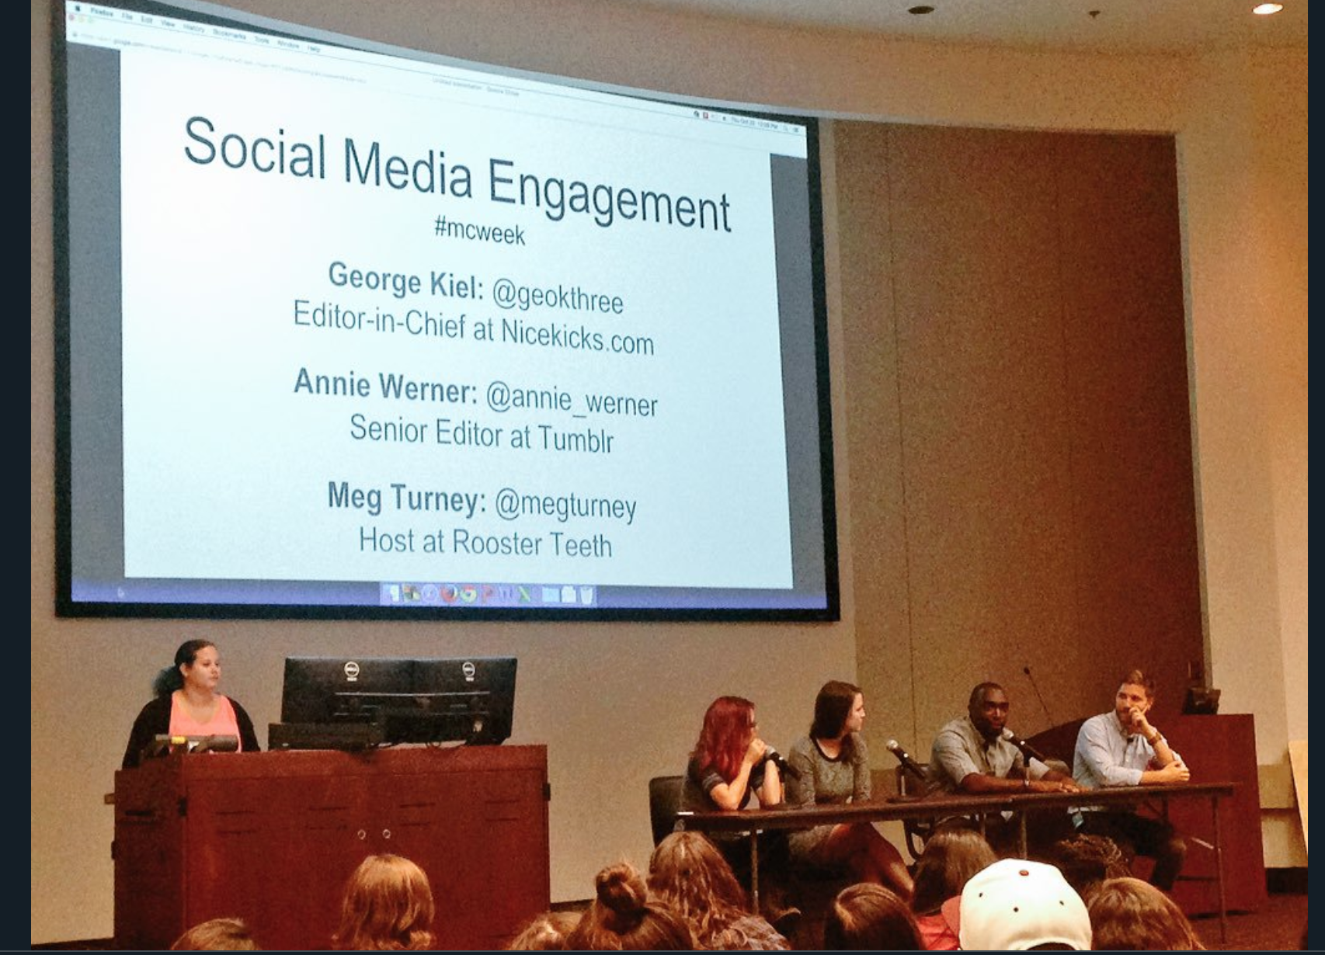
FDOM

Slide 17
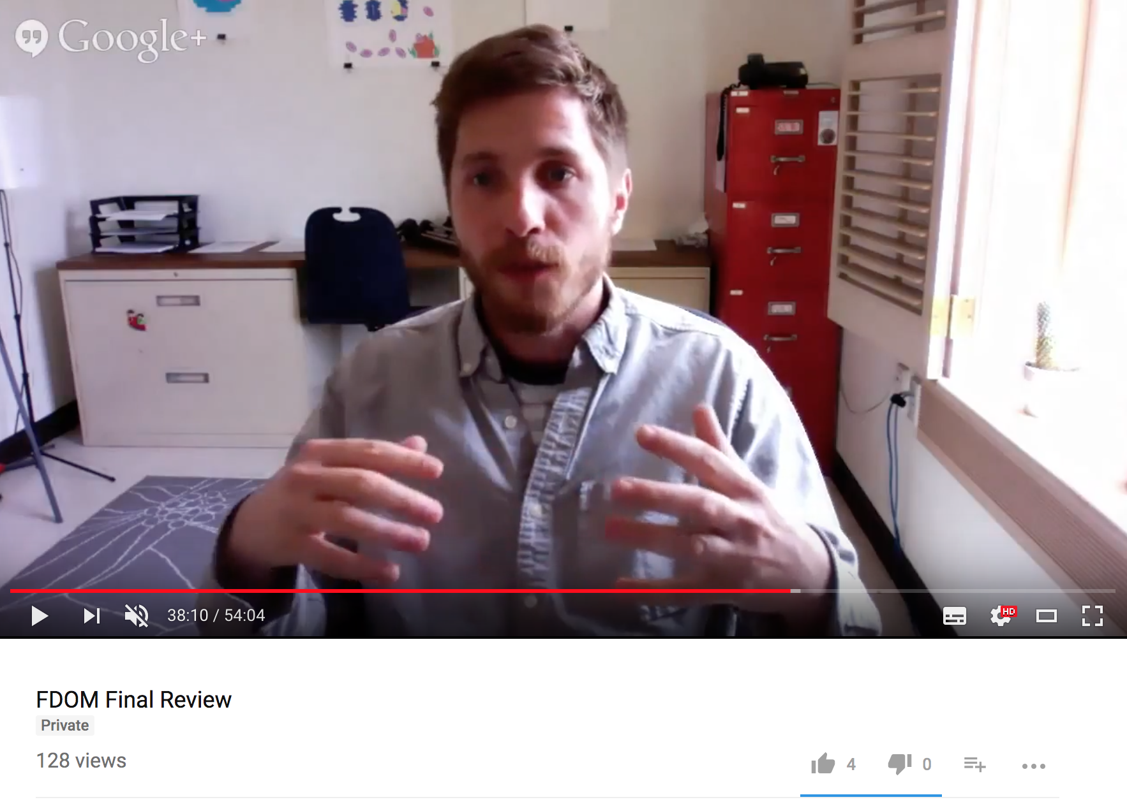
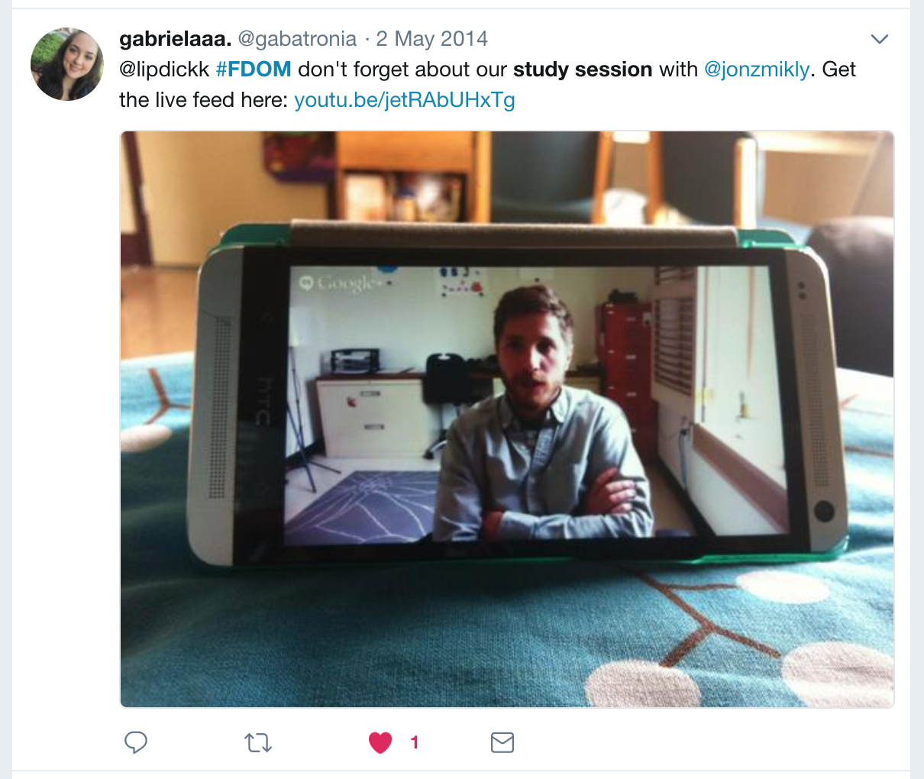
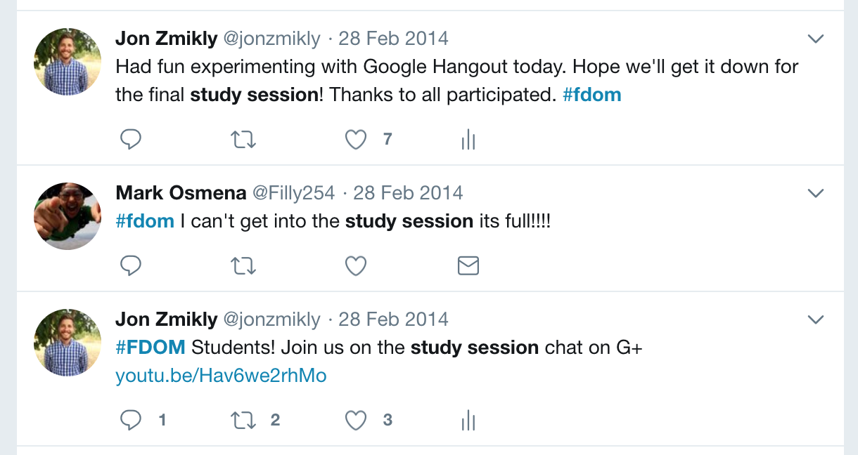
FDOM

Slide 18

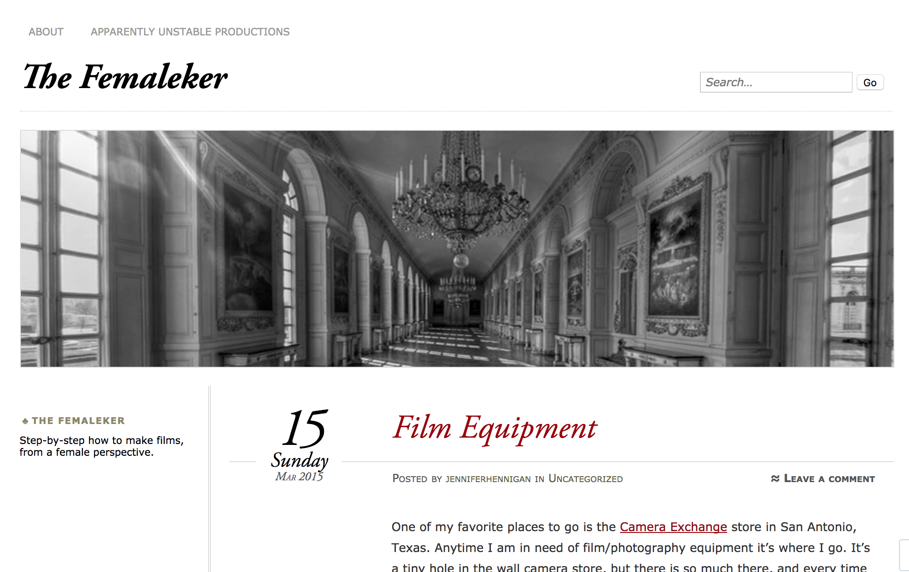
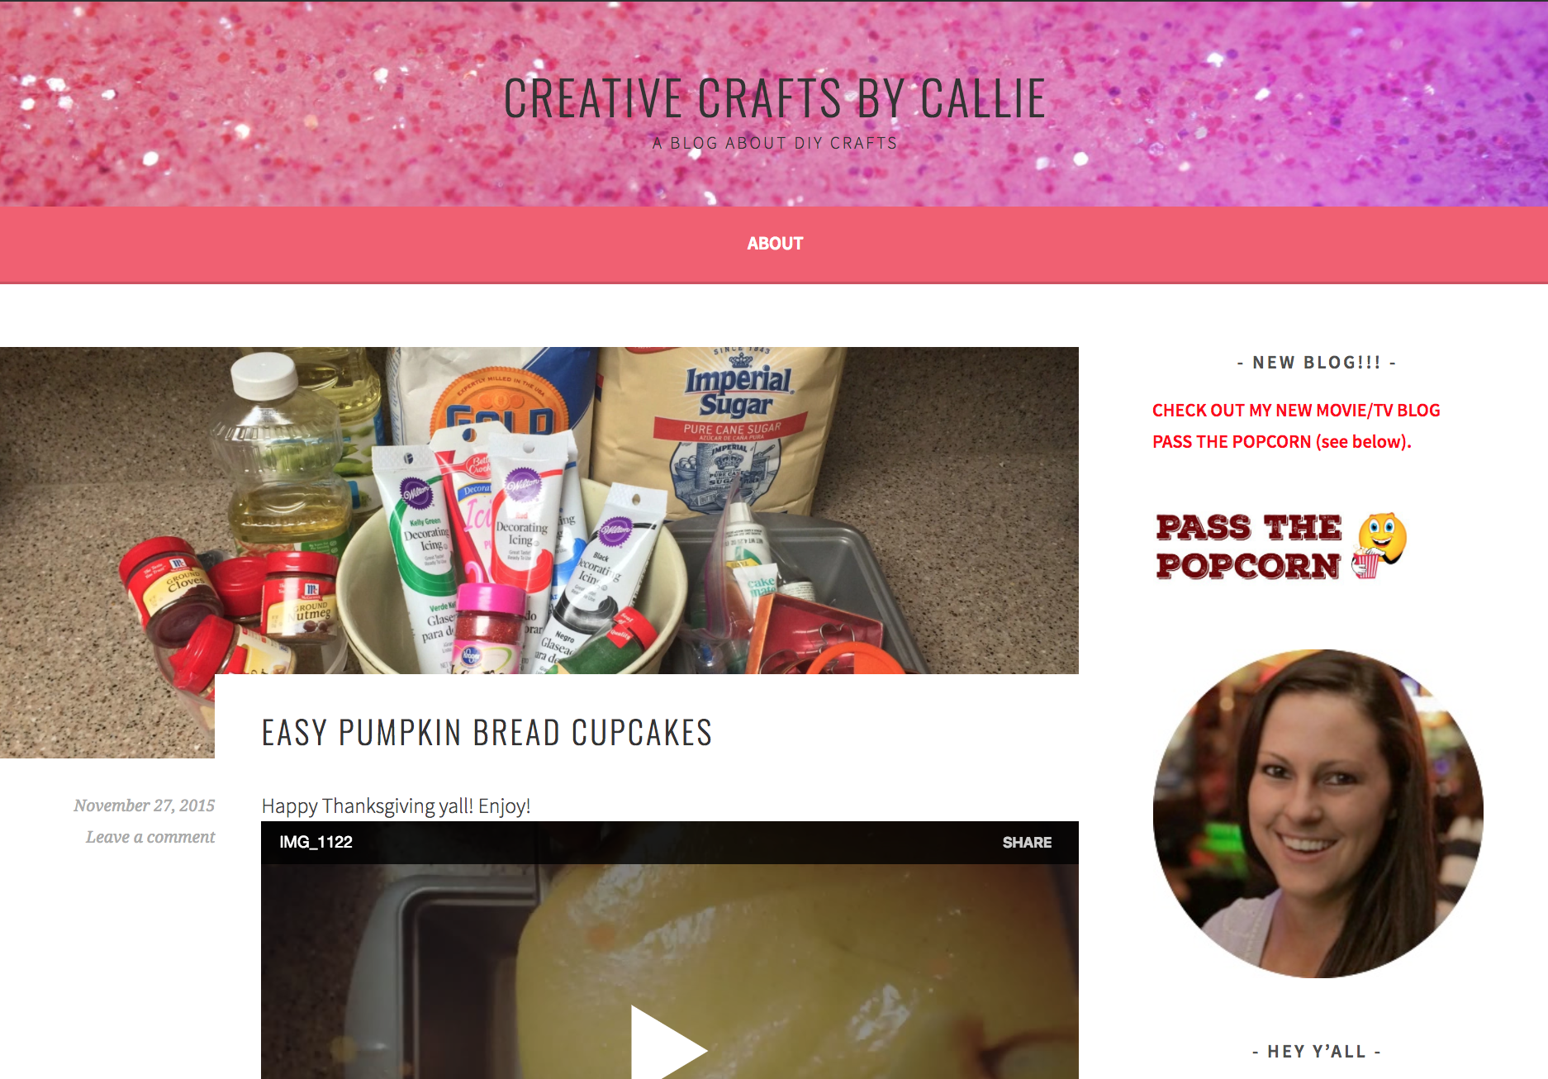
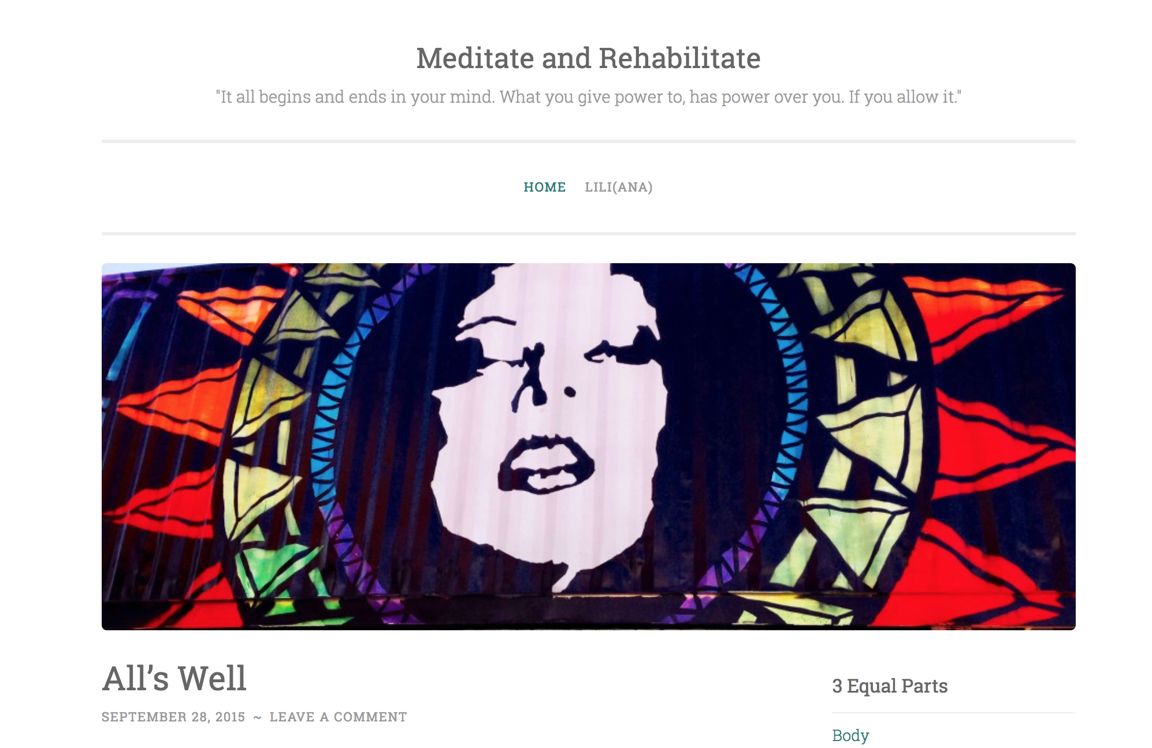
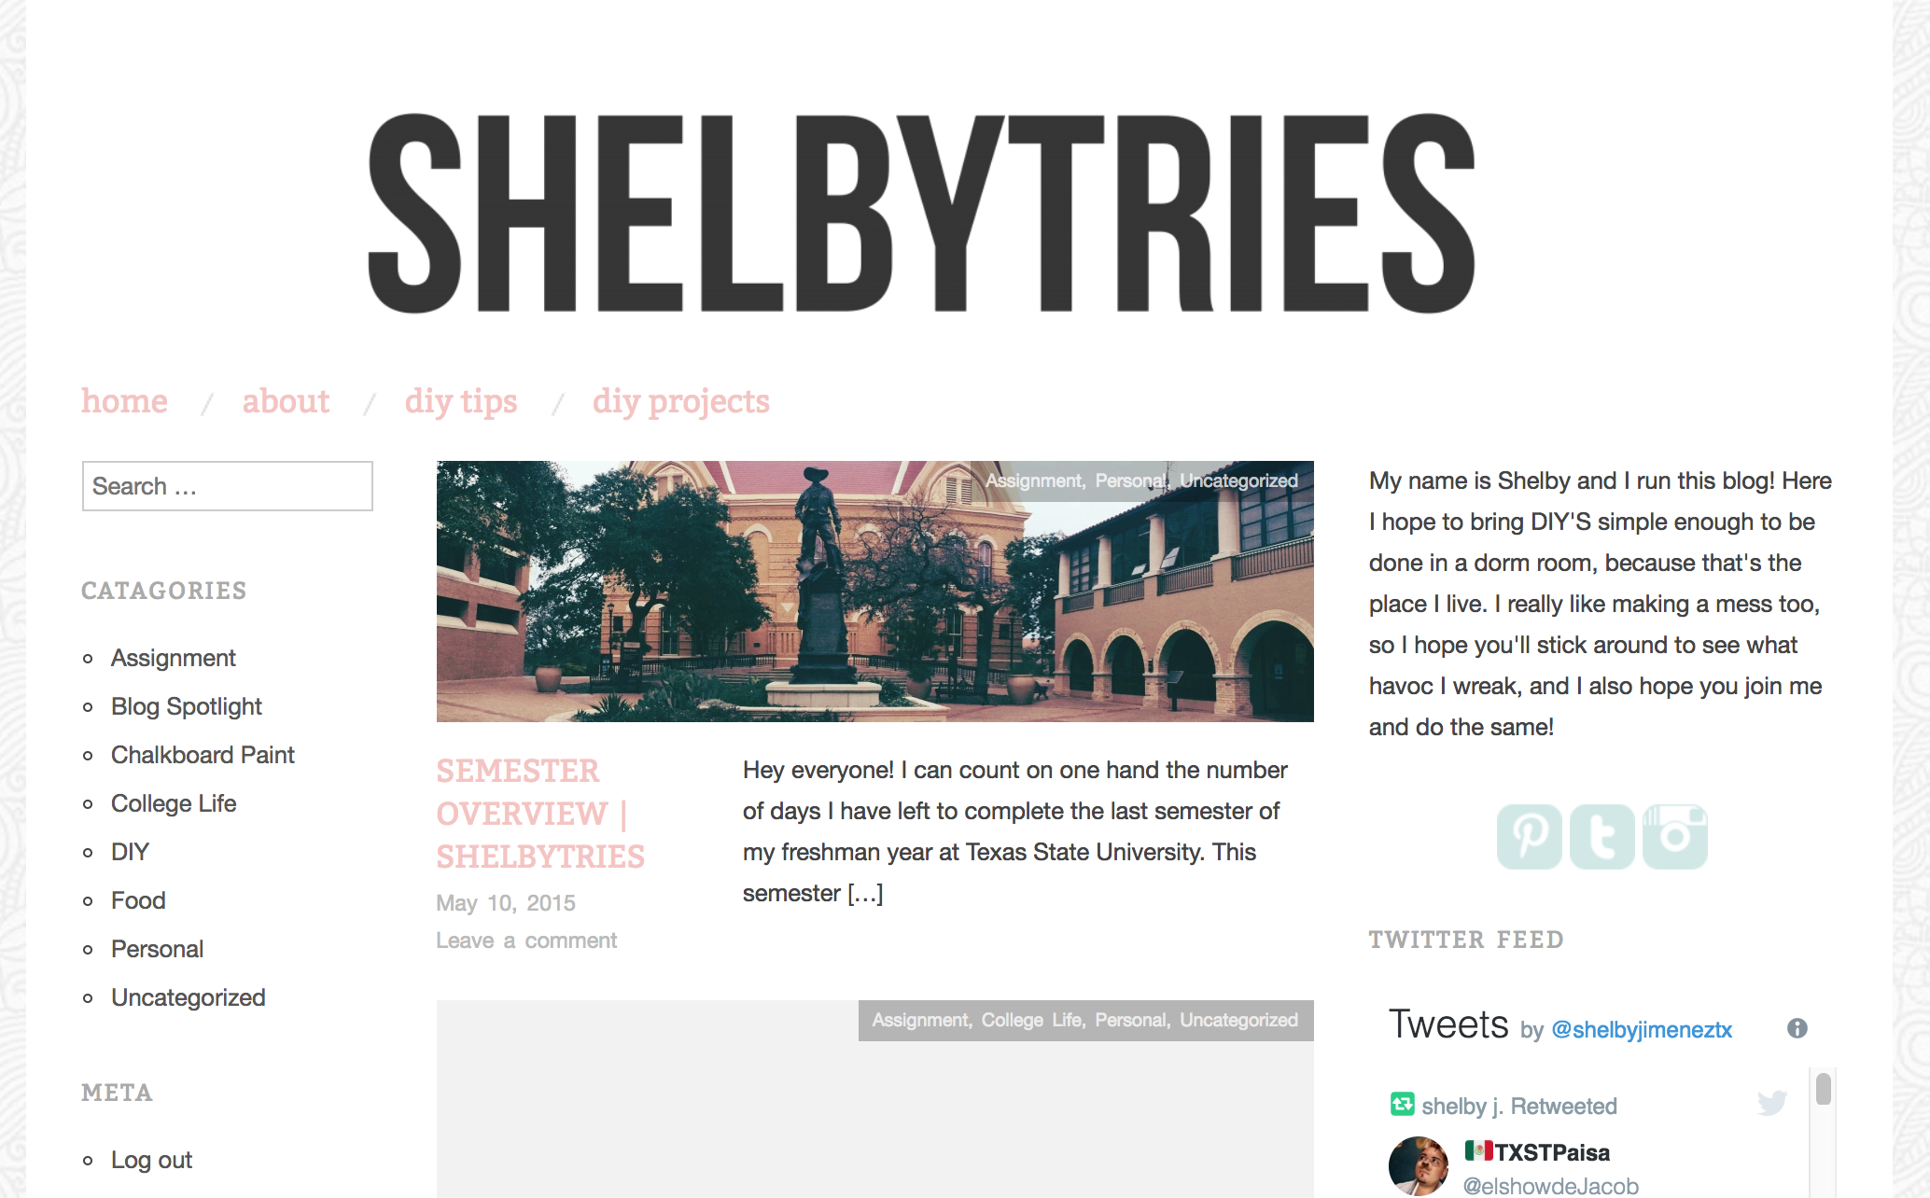
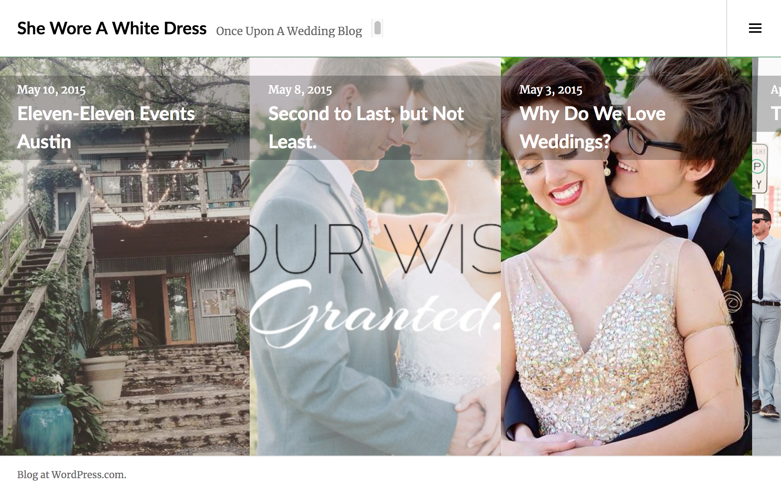
FDOM
Below are some examples of student website projects. Topics ranged from music to entertainment to hunting to pet ownership and much, much more. It was always interesting reading about our students’ adventures and thoughts on specific topics.

Slide 19

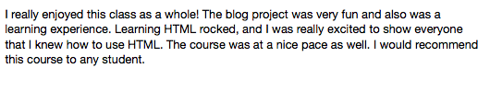
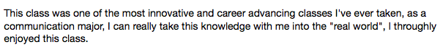
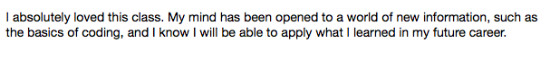
Past Student feedback

Slide 20
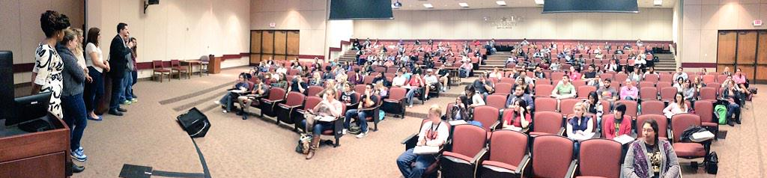
Teaching Fdom
Students often fail to see how social media can be used beyond communicating with their social spheres.
We will be using social media in and outside the classroom.
Twitter / Facebook to answer questions, post news articles, ask questions, remind them of deadlines and reinforce material, post notes, etc. I will be using Instagram for announcements, reminders
Convenient and less intimidating than asking a question in a large lecture hall, helps build community
Students helping students
Build your profiles now if you haven’t already!

